Slide 1
Liquid Crystal Institute
Determination of refractive indices of liquid crystal elastomer
Israel Lazo, Jeremy Neal and Peter Palffy-Muhoray
Liquid Crystal Institute, Kent State University, Kent OH, 44242

Slide 2
Motivation and Objectives
Understand the physical properties of this new materials
Measure the individual refractive indices of a nematic liquid crystal elastomer
Determine how this refractive indices change as a function of strain

Slide 3
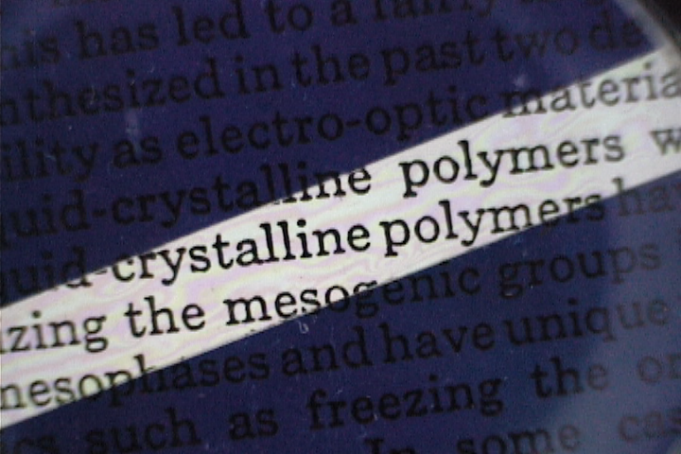
LC elastomer
O
O
O
O
Mesogen
CH₃
CH₃
CH₃
H
Si
O
Si
O
Si
H
CH₃
H
CH₃
₈₅
Backbone
O
CH₂
CH₂
O
Crosslinker

Slide 4
Refractive indices
LC elastomer
LC
n
n
E
k
k
E
n_{o}
n_{e}
Techniques:
Brewster’s angle measurement
Interferometry

Slide 5
Brewster’s angle
Detector
He-Ne
θ_{i}
π-polarization
n
Sample
Holder
Brewster’s angle!
Schematic diagram of the experimental setup for Brewster’s angle measurements

Slide 6
Brewster’s angle (Model)
n
z
x
E
Sample
Vertical configuration
n
z
E
x
Sample
Horizontal configuration
pv

Slide 7
Mathematical model
E_{i}
E_{r}
H_{i}
k_{i}
θ₁
Elastomer’s surface
E_{t}
θ₂
β
D_{t}
θ₂
n
k_{t}
s

Slide 8
Results
S increases with strain
Experimental results for Brewster’s angle technique

Slide 9
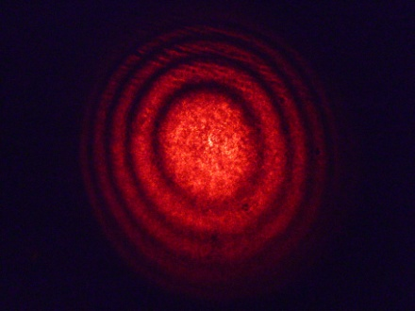
Interferometry
M
L
He-Ne
Sample
M
BP
M: Mirror
L: Lens
E
n
Schematic diagram of the experimental setup for conoscopic interferometer

Slide 10
Interferometer
Phase shift
Ordinary refractive index
n_{o}→n₂
Special consideration must be taken when calculating n_{e}

Slide 11
Experimental results for Interferometer and Brewster’s angle techniques

Slide 12
Conclusion
We have measured the ordinary and extraordinary refractive indices of a nematic liquid crystal elastomer using two different methods
Two methods are in a good agreement
To do
Confirm and interpret the results.

