Slide 1
LCE swelling experiment
Vianney Gimenez
Prof. Peter Palffy-Muhoray

Slide 2
Liquid Crystal Elastomer
LC elastomers are polymer networks formed by cross linking liquid crystalline polymers.
These polymers are typically connected to rod like molecules that distort the conformation of the polymer

Slide 3
Fabrication of samples
Principal compounds
Liquid Crystal Nematic Mesogen
Polymer-Backbone
Cross linker
Toluene
Catalyzer
Preheated centrifugation around 60 min
Stretching the elastomer for induced alignment.
Wash and Bake the elastomer

Slide 4
Liquid Crystal Elastomer
Coupling between strain and nematic tensor in free energy

Slide 5
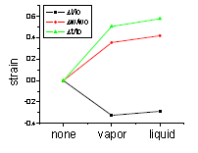
Swelling mismatch
LCE in liquid solvent is
more swollen than in vapor!
Swelling should be the same in liquid solvent and vapor solvent.
There is coexistance so chemical potencial should be the same
Previous work.
“Swelling Dynamics and Related Phenomena in NematicElastomers”
P. Palffy-Muhoray, P. Luchette , et al

Slide 6
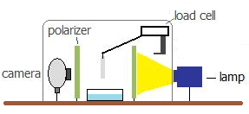
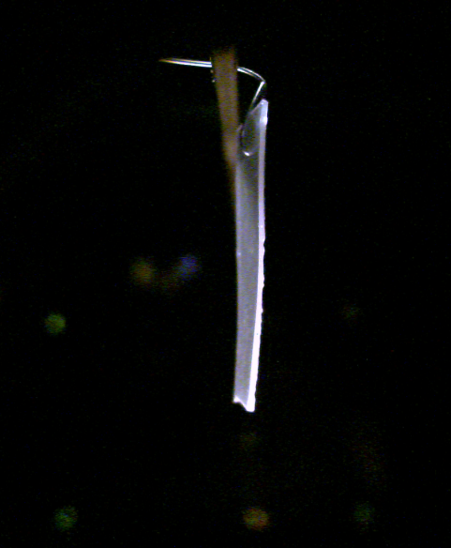
Experimental Setup
We registered the swelling of an elastomer as a function of time in presence of toluene vapor
Pictures registered the change in the elastomer sample geometry

Slide 8
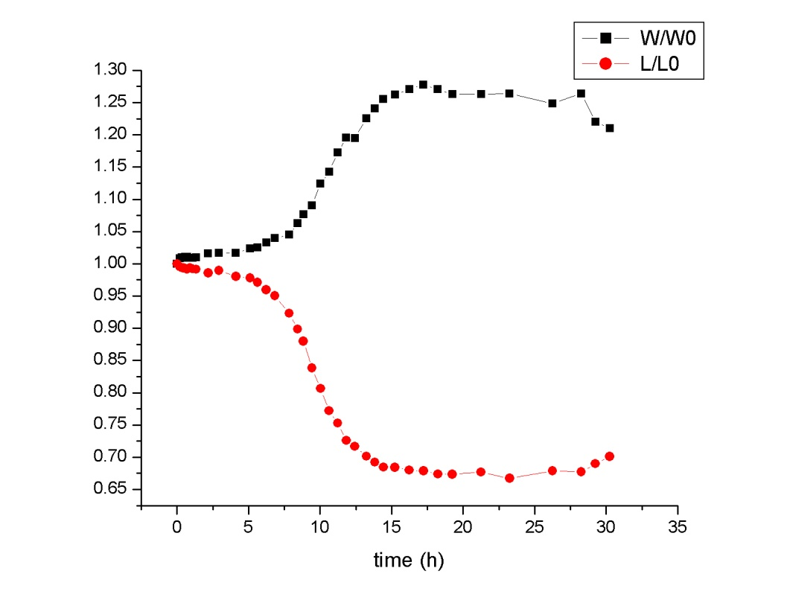

Slide 10
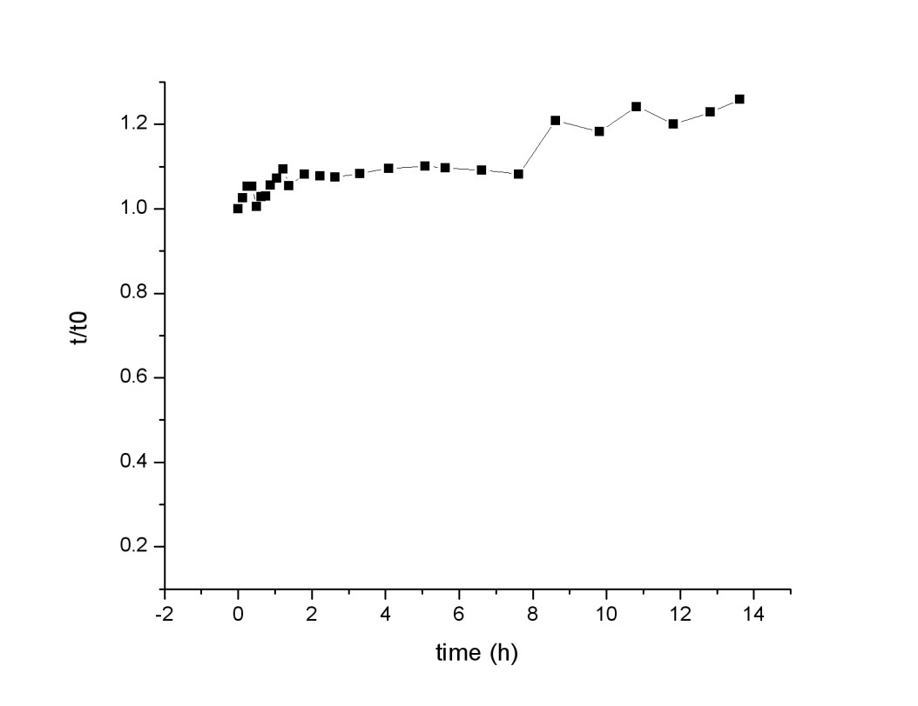

Slide 11
Future work
Apply the studies to elastomers of different geometries.
Make a more uniform exposure of the elastomer to the toluene vapor
Study the reaction of a Poly-domain LC elastomer.

Slide 12
Acknowledgment
Paul Luchette ….. so much
Michelle Moreira
Jake Fontana
Sabrina Relaix
Jeremy Neal
Prof. Peter Palffy-Muhoray
Fontana

