Slide 1
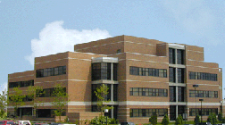
Measuring Refractive Indices of Nematic LC Elastomers
Volodymyr Borshch
Research advisor: Professor Peter Palffy-Muhoray
25 August 2008

Slide 2
Outline
Motivation
Nematic LC elastomer
Methods and previous results
Theory
Materials selection
Experimental setup
Obtained data
Conclusions
Acknowledgments

Slide 3
Motivation
Nematic LC Elastomers have bright future
Not all physical properties are quite extensively described so far
E.g. Refractive index

Slide 4
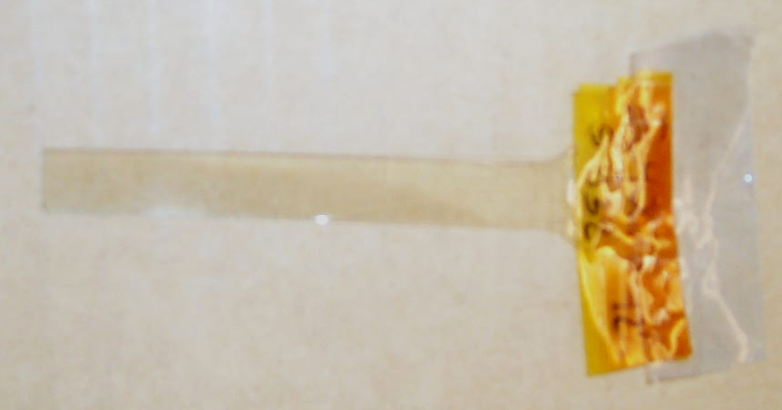
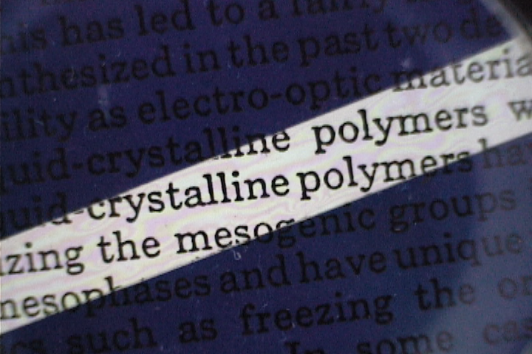
Nematic LC elastomer
O
O
O
O
Mesogen
CH₃
CH₃
CH₃
H
Si
O
Si
O
Si
H
CH₃
H
CH₃
₈₅
Backbone
O
CH₂
CH₂
O
Crosslinker
From Israel Lazo presentation

Slide 5
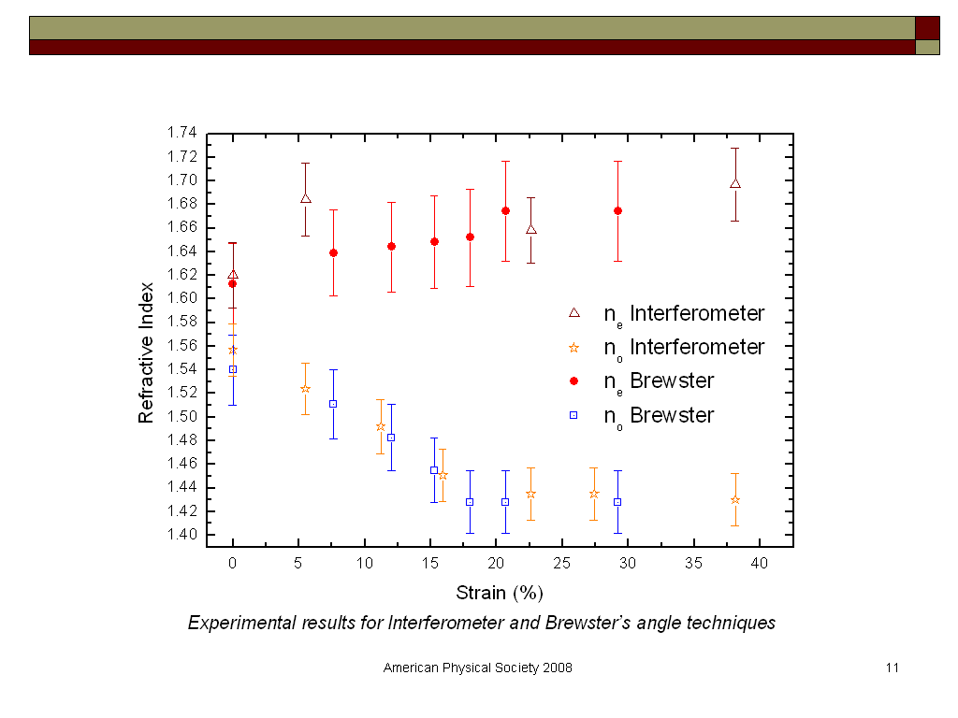
Methods
Israel Lazo presentation
Notes:
The results are puzzling
To be confirmed

Slide 6
Yet another approach
From Fresnel equations:
The main idea of the method R=0

Slide 7
High refractive index liquids
Liquids at or near 20˚C
Ionic liquids based on 1-alkyl-3-methylimidazolium cations
Refractive index | Material
1.627 | Quinoline
1.660 | α-Monobromonaphthalene
1.717 | Mercury potassium iodide
1.737 | Methylene iodide
1.78 | Methylene iodide and sulphur (saturated)
1.793 | Barium mercuric iodide aq.
1.82 | Potassium iodide and mercuric iodide aq.
1.868 | Solutions of 35% by weight CH₂I₂, 31% SnI₄, 16% AsI₃, 8% SbI₃ and 10% S
1.885 | Hydrogen disulphide
1.95 | Phosphorus in carbon disulphide
2.06 | Yellow phosphorus 8 parts by weight + 1part sulphur + 1 methylene iodide
2.2 | Mercuric iodide in aniline or quinoline
Most of them were either:
- Highly toxic and poisonous - Not transparent - Not available
A simple, cost-effective and magnificent liquid was used – saturated solution of NaI
n = 1.496
Data from Kaye and Laby, Tables of Physical and Chemical Constants, 1959

Slide 8
Experiment
Rotating polarizer
Fish tank with immersed elastomer
Beam splitter
λ/4 plate
HeNe
Reference beam
lens
632.8 nm filter
detector
detector
Experimental setup
Measuring the reflectance of the elastomer in normal incidence
Lock-in amplifier

Slide 9
n_{o} measurement
The polarization is perpendicular to the preferred director orientation n
Fitting and extrapolation gives n=1.60365
±0.01633
The sample from batch #69 gave similar value n=1.53529
elastomer with no strain
batch #71 (10% cross linkers)

Slide 10
n_{e} measurement
The polarization is parallel to the preferred director orientation n
Fitting and extrapolation gives n =1.64128
±0.03830
elastomer with no strain
batch #71 (10% cross linkers)

Slide 11
Benefits and drawbacks of the method
Looks simple
Inhomogeneity of elastomer
Scattering

Slide 13
Conclusions
The sample was different but the results agree with previous measurements
The refractive indices need to be measured more accurately
Future work: Generalized Ellipsometry
Need to measure inhomogeneity
Notes:
Handbook of Ellipsometry, edited by Harland G. Tompkins, Eugene A. Irene
William Andrew publishing, 2005, ISBN: 0-8155-1499-9
Chapter 9. Theory and Application of Generalized Ellipsometry
by Mathias Schubert

Slide 14
Acknowledgement
Prof.Peter Palffy-Muhoray
Jake Fontana, Israel Lazo
Paul Luchette, Michele Fontana
Jeremy Neal, Sabrina Relaix
Rafael Zola

Slide 15
Thank you !

