Slide 1
Characterization of Swelling of Liquid Crystal Elastomers
Sarah Hicks
Palffy lab
Spring 2007

Slide 2
Outline
Introduction
Liquid crystal elastomers (LCE)
New Liquid Crystal Materials Facility
Experiment
Swelling/Deswelling
Dynamic Swelling
Results

Slide 3
INTRODUCTION: LIQUID CRYSTAL ELASTOMERS (LCE)
LCE:
combination of polymer rubber with anisotropic liquid crystal¹
coupling of orientational order and mechanical strain²
sample orientation can be achieved by applying mechanical stretching^{3,4} or by cross-linking⁵

Slide 4
Introduction: Liquid Crystal Materials Facility (NLCMF)
NLCMF
Provide LCE samples developed by different groups to community
Duties
Aided in the construction of smectic LCE
Development of NLCMF Website
Characterization of Nematic LCE
measured strain of sample versus toluene concentration

Slide 5
Introduction: Diffusion
D=diffusion coefficient
ρ=density
t=time
thickness of elastomer
for liquids:
So, t = 90 s

Slide 6
Experiment: Swelling/Deswelling
Sample: 10% cross-linked nematic liquid crystal elastomer
Procedure: Circulate hexane solvent into sample. Add toluene in to hexane. Record strain as a function of toluene concentration and time. Decrease toluene concentration. Record changes in sample.

Slide 7
Experiment: Set-Up

Slide 8
Results: Swelling
║
┴

Slide 9
Results: Swelling

Slide 10
Results: Swelling

Slide 11
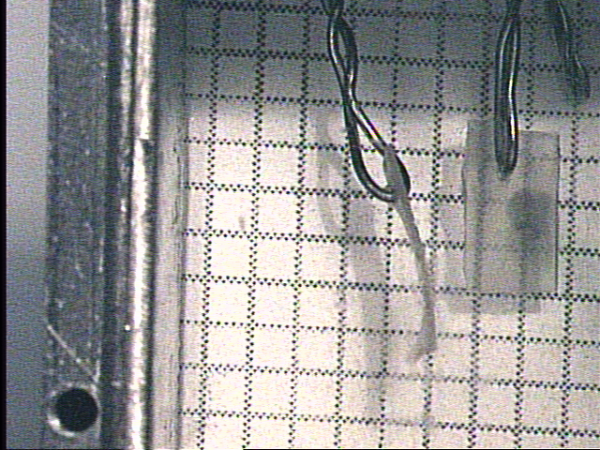
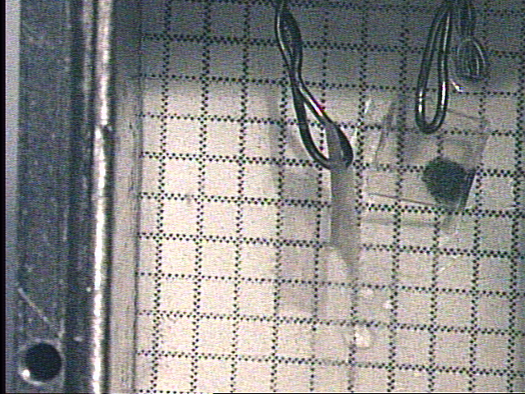
Results: Swelling
Sample at 0% toluene
Sample at 22% toluene

Slide 12
Results: Deswelling

Slide 13
Results: Deswelling

Slide 14
Results: Deswelling

Slide 15
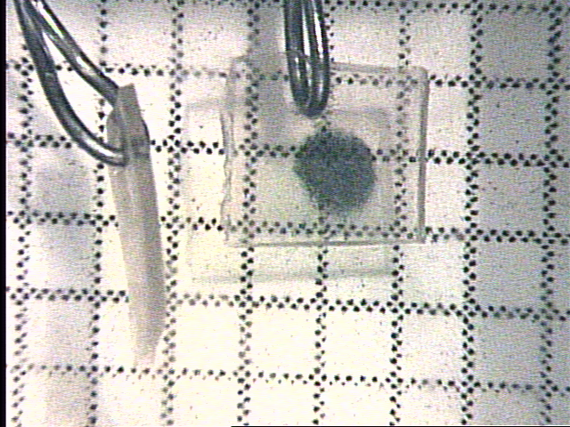
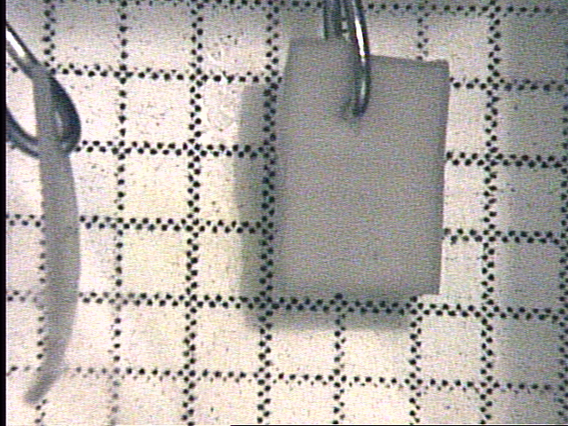
Results: Deswelling
Sample at 22% toluene
Sample at 0% toluene
after 3 hours and 20 minutes

Slide 16
Experiment: Dynamic Swelling
Sample was soaked in a mixture of 15% toluene and the change in dimensions were recorded using a camera.
Sample was in the mixture for approximately 90 minutes.

Slide 17
Results: Dynamic Swelling

Slide 18
Conclusion
With increasing toluene concentration, the strain perpendicular to the nematic director increased while the strain parallel to director decreased. It was vice versa as the concentration was decreased. The perpendicular component was positive and the parallel component was negative.
Also, the sample transitioned into the isotropic phase as concentration increased. As the toluene concentration decreased, the sample transitioned back to nematic phase.
With the concentration kept constant, the strain perpendicular to the director increased while the strain parallel to director decreased as time progressed before reaching an equilibrium.

Slide 19
References
1. W. Gleim and H. Finklemann, Side Chain Liquid Crystalline Polymers, edited by C. B. McArdle, Glasgow: Blackie (1989).
2. H. Schuring, R. Stannarius, C. Tolksdorf, R. Zentel. Macromolecules 34 3962 (2001).
3. T. Eckert, H. Finkelmann. Macromol. rapid Commum., 17 767 (1996).
4. K. Semmler, H. Finkelmann, Macromol. Chem. Phys., 196 3197 (1995).
5. R. Kohler, R. Stannarius, C. Tolksdorf, R. Zentel. Appl. Phys. A 80 381 (2005).

