Slide 1
Liquid Crystal Elastomer Dielectric Constant Measurements
Jeremy Neal
P.Palffy-Muhoray
Liquid Crystal Institute
Kent State University
Kent, Ohio
Ferroelectric Workshop – Kent State University Saturday, June 23, 2007

Slide 2
Liquid Crystal Elastomers
liquid crystal + rubber
LC nematic monodmain
synthesize here - need to characterize
LC mesogen
polymer backbone
cross-linker

Slide 3
Experiment 1
Ne Trans.
ITO Glass
Elastomer
Variac
Elastomer is suspended on a string between two parallel pieces of ITO
coated glass. Elastomer aligns along sufficiently strong applied field.

Slide 4
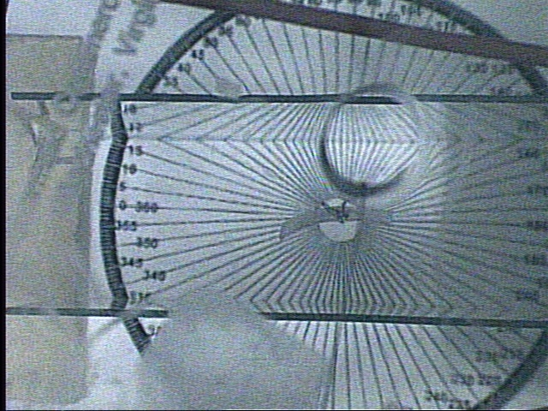
Video of Experiment

Slide 5
Experimental Data
Field On
Field Off

Slide 6
Overview
Want to solve

Slide 7
Theory
Energy of elastomer:

Slide 8
Theory
In general:
where

Slide 9
Theory
cont’d
Make substitutions:
then

Slide 10
Theory
Choose A & B such that
then

Slide 11
Theory
Recall
Thus
Want to solve

Slide 12
Theory
Also
So
where
Need the following:

Slide 13
Depolarizing Factors
Assume depolarizing factors for an ellipse can be used:

Slide 14
Elastomer Properties
w
d
l

Slide 15
Electric Field Measurement
Voltage divider:
R₁
V_{in}
R₂
V_{out}
Thus

Slide 16
Experiment 2
spacers
Capacitance Bridge
Elastomer
Al plates
C_{U}
C_{B}
Elastomer is sandwiched between aluminum plates and capacitance is measured with bridge
V_{out}

Slide 17
Theory & Results
Without elastomer:
Using
Find
With elastomer:
Find

Slide 18
Results
Using:
LHS
RHS

Slide 19
Possible Future Work
Remove shape effects:
OR
Remove anisotropy effects:
Repeat experiments in magnetic field

Slide 20
Conclusions
Electric field response used to determine elastomer dielectric constant values
Would like to do similar magnetic field measurements
Still a work in progress

