Slide 1
Swelling Dynamics of Liquid Crystalline Elastomers
Jun Geng
Lquid Crystal Institute
Kent State University
Advisor: Dr. Peter Palffy-Muhoray

Slide 2
Outline
Liquid crystal elastomer (LCE) sample details and preparation
Analysis of swelling based on Van der Waals intermolecular potential
Solvent swelling experiment
Solvent vapor swelling experiment
Liquid Crystal Institute, KSU
2

Slide 3
LCE Details & Preparation
Finkelmann Spin Cast Nematic side chain LCE
methylsiloxane backbone
biphenyl mesogen
(side group)‏
tri-functional crosslinker
Liquid Crystal Institute, KSU
3

Slide 4
Simple Analysis
Liquid Crystal Institute, KSU
4

Slide 5
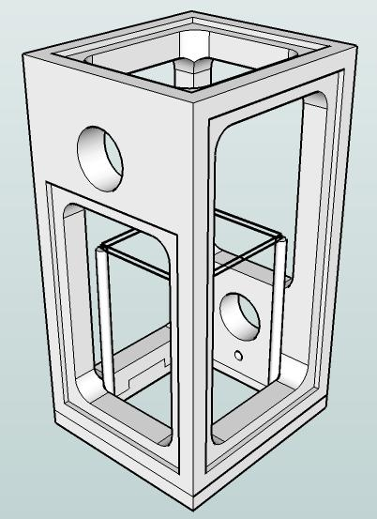
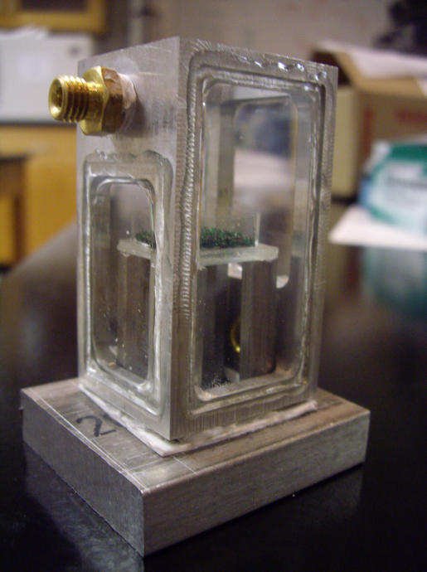
Solvent Swelling Experiment
Designed measurement cell to simultaneously monitor
Initial problems:
  Solvent leaking
  UV glue degradation
Liquid Crystal Institute, KSU
5

Slide 6
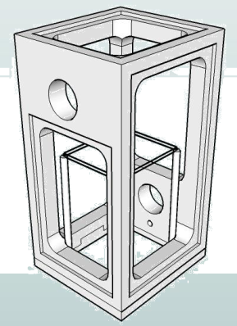
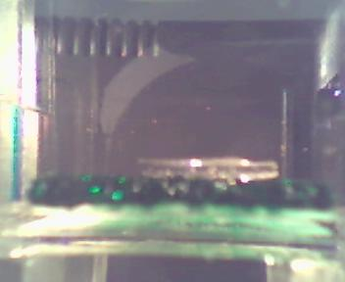
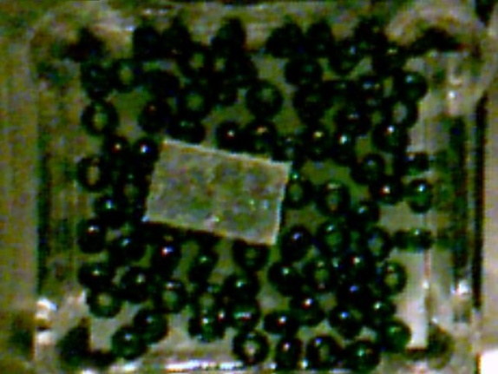
Swelling Experiment
solvent pump
sample holder
solvent reservoir

Slide 7
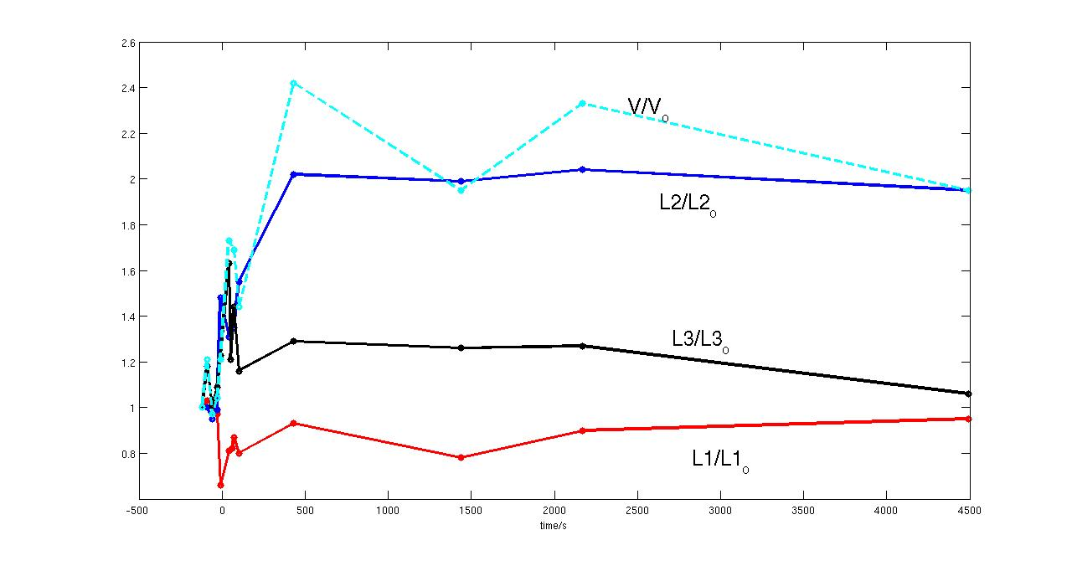
LCE
L3
director
L2
L1

Slide 8
Solvent Vapor Swelling

Slide 9
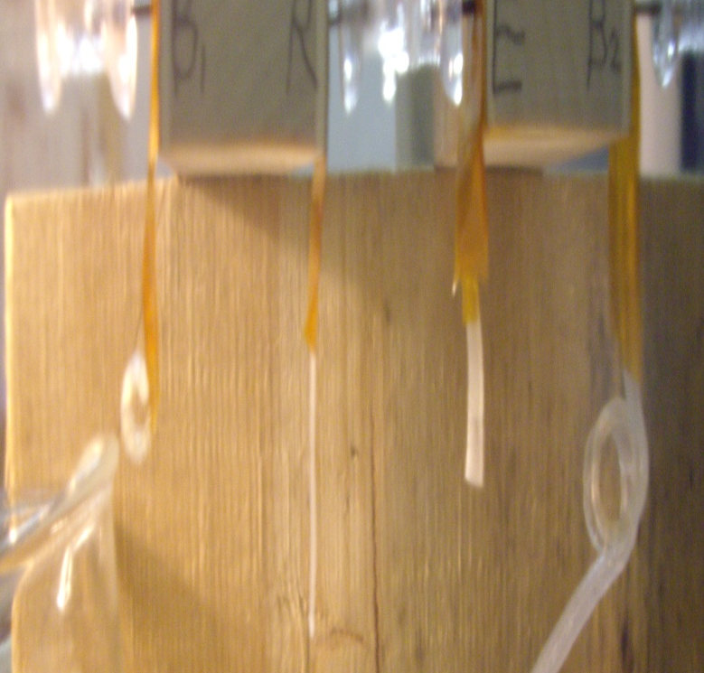
LCE Bi-Rubber Strip Swelling
Normal Rubber: RTV
Toluene Vapor
Liquid Crystal Elastomer
Toluene
Liquid Crystal Institute, KSU
9

Slide 10


Slide 11
Conclusion

Slide 12
Thanks to:
Jeremy taught me how to use those machines in machine shop and supervised my activities, Paul who showed me how to make the elastomers, Michele who lent me a key to the lab, and Jake who told jokes sometimes.

