Slide 1
Liquid Crystalline Elastomers
Jeremy Neal
Liquid Crystal Institute - Kent State University
Kent, OH
Work supported by NSF-EC DMR 0132611

Slide 2
Liquid Crystal Elastomers
Conventional rubber
rubber backbone
cross-linker
LCE: liquid crystal rubber
liquid crystal unit
rubber backbone
cross-linker

Slide 3
LCE Composition
Rubber backbone (main chain)
Liquid crystalline unit
(side group)
Crosslinker

Slide 4
Elastomer Shape Changes
L
Heating
L
W
W

Slide 5
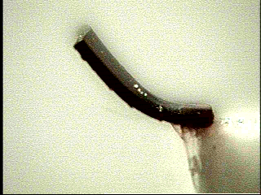
Light Induced Bending of LCEs
laser illumination causes the elastomer to bend towards the beam, as shown
Ar
Laser
Sample
1.5 cm

Slide 6
Elastomer Fish
Argon Laser
Mirror
shutter
Switchable Mirror
Elastomer Fish
(3 x 6 mm)
LabVIEW
switchable mirror allows alternate illumination of each side of LCE sample

Slide 7
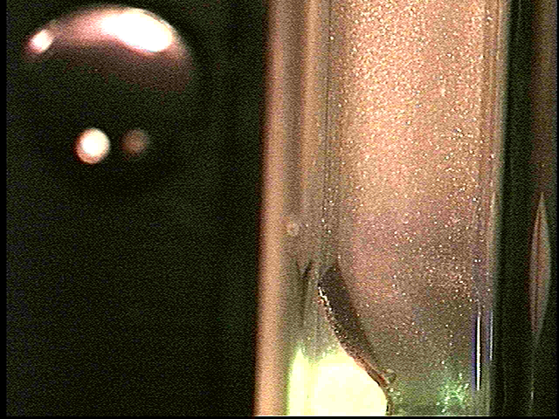
Elastomer Fish
sample immersed in rheoscopic fluid, which allows for flow visualization
sample is illuminated alternately on both sides by light at 514nm from Ar laser

Slide 8
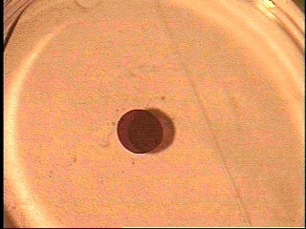
Another Elastomer Fish
Shape changes propagate like a wave down the sample causing it to swim
away from the light.

Slide 9
Conclusions
LCEs add a LC component to a conventional rubber
LCEs have unique properties
Many potential applications for LCEs
Need more research for commercialization

