Slide 1
An Artificial Light Driven Goldfish
Jeremy Neal
Peter Palffy-Muhoray
Tibor Toth-Katona
Heino Finkelmann
Michael Shelley
Liquid Crystal Institute
Kent State University
Kent, OH
Institute fur Macromoleculare Chemie,
Albert-Ludwigs Universitat, Freiburg, Germany
Courant Institute of Mathematical Sciences,
New York University, NY
Work supported by NSF-EC DMR 0132611

Slide 2
Project Aims:
to understand how soft active materials interact with a fluid environment as in:
folding & motion of leaves in wind
fish swimming in water
peristaltic pumps
to better understand of the interaction between light and liquid crystal elastomer (LCE) materials

Slide 3
Liquid Crystal Elastomers
LCE: liquid crystal rubber
mesogenic unit
backbone
cross-linker
strong coupling between nematic order and mechanical strain
order parameter changes induce shape changes
light can change the order parameter, resulting in shape changes

Slide 4
Elastomer Free Energy
Liquid Crystals: Order Parameter Tensor Q_{αβ}
Elastomers: Strain Tensor ε_{αβ}
Nematic Free Energy
E-field Term
Elastomer Free Energy
Coupling Term
C – constant
η – Young’s modulus
– external stress tensor

Slide 5
Light Induced Order Parameter Changes
Light can change the order parameter via:
direct heating of the sample
disruption of nematic order due to photoisomerization
direct optical torque due to direct angular momentum transfer from the light
indirect optical torque
All these mechanisms could be contributing.

Slide 6
LCE Composition
methylsiloxane monomer (main chain)
mesogenic biphenyl
(side group)
trifunctional crosslinker

Slide 7
Our LCE Materials
samples have the following properties:
nematic monodomain
8 – 12% cross-linking
0.1% dissolved azo-dye
Typical LCE sample size.

Slide 8
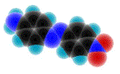
Azo-Dyes
contain a N = N double bond connecting aromatic benzene rings
undergo photoisomerization, from the trans- to cis- configuration on absorption of a photon
align with the nematic director
are dissolved in our LCEs to aid in light absorption
hν
kT , hν’
trans-
cis-

Slide 9
Light Induced Bending of LCEs
laser illumination causes the elastomer to bend towards the beam, as shown
Ar
Laser
Sample
1.5mm

Slide 10
Experiment
Argon Laser
Mirror
shutter
Switchable Mirror
Elastomer Fish
(3 x 6 mm)
LabVIEW
switchable mirror allows alternate illumination of each side of LCE sample

Slide 11
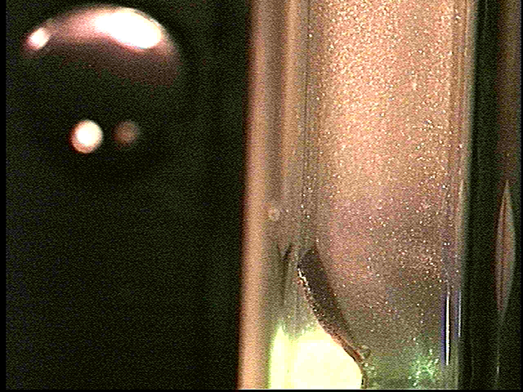
Experiment
sample immersed in rheoscopic fluid, which allows for flow visualization
sample is illuminated alternately on both sides by light at 514nm from Ar laser

Slide 12
Experimental Results
Fluid velocities for various elastomer driving excitations
highest pumping rates are achieved with the shortest delay time between laser pulses
all curves peak near the same exposure time of 700 ms

Slide 13
Momentum Transfer
laser light provides energy to the LCE, but not momentum
energy transfer induces a stress in the LCE sample, causing it to bend.
bending of the elastomer sample transfers momentum to the surrounding fluid
fluid transfers momentum to the LCE sample
This is similar to a conventional motor, where energy is used to cause momentum transfer.

Slide 14
Drag Reduction
Grey’s Paradox*: actively swimming fish experience a significant drag reduction through the swimming process
possibly due to
viscous damping by fluid cells under the skin
swimming motion
we would like to determine if soft active materials can lead to a drag reduction
could lead to new applications such as
soft active materials to coat boats for reduced energy consumption
* Gray, J. Studies in animal locomotion, J. Exp. Biol. 13, pp. 192-199 (1936).

Slide 15
Conclusions
laser supplies energy to the system which results in momentum transfer between fish & surrounding fluid
fluid is pumped backwards
results of this experiment will be compared with modeling
expect new insight into soft active materials
Future work
design experiment to determine if drag reduction is present in our system

